Slide 1
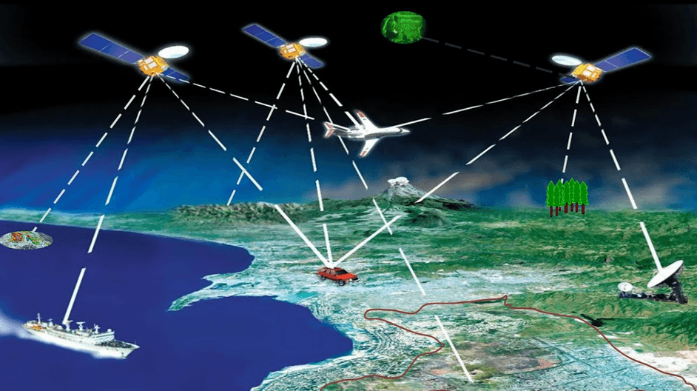

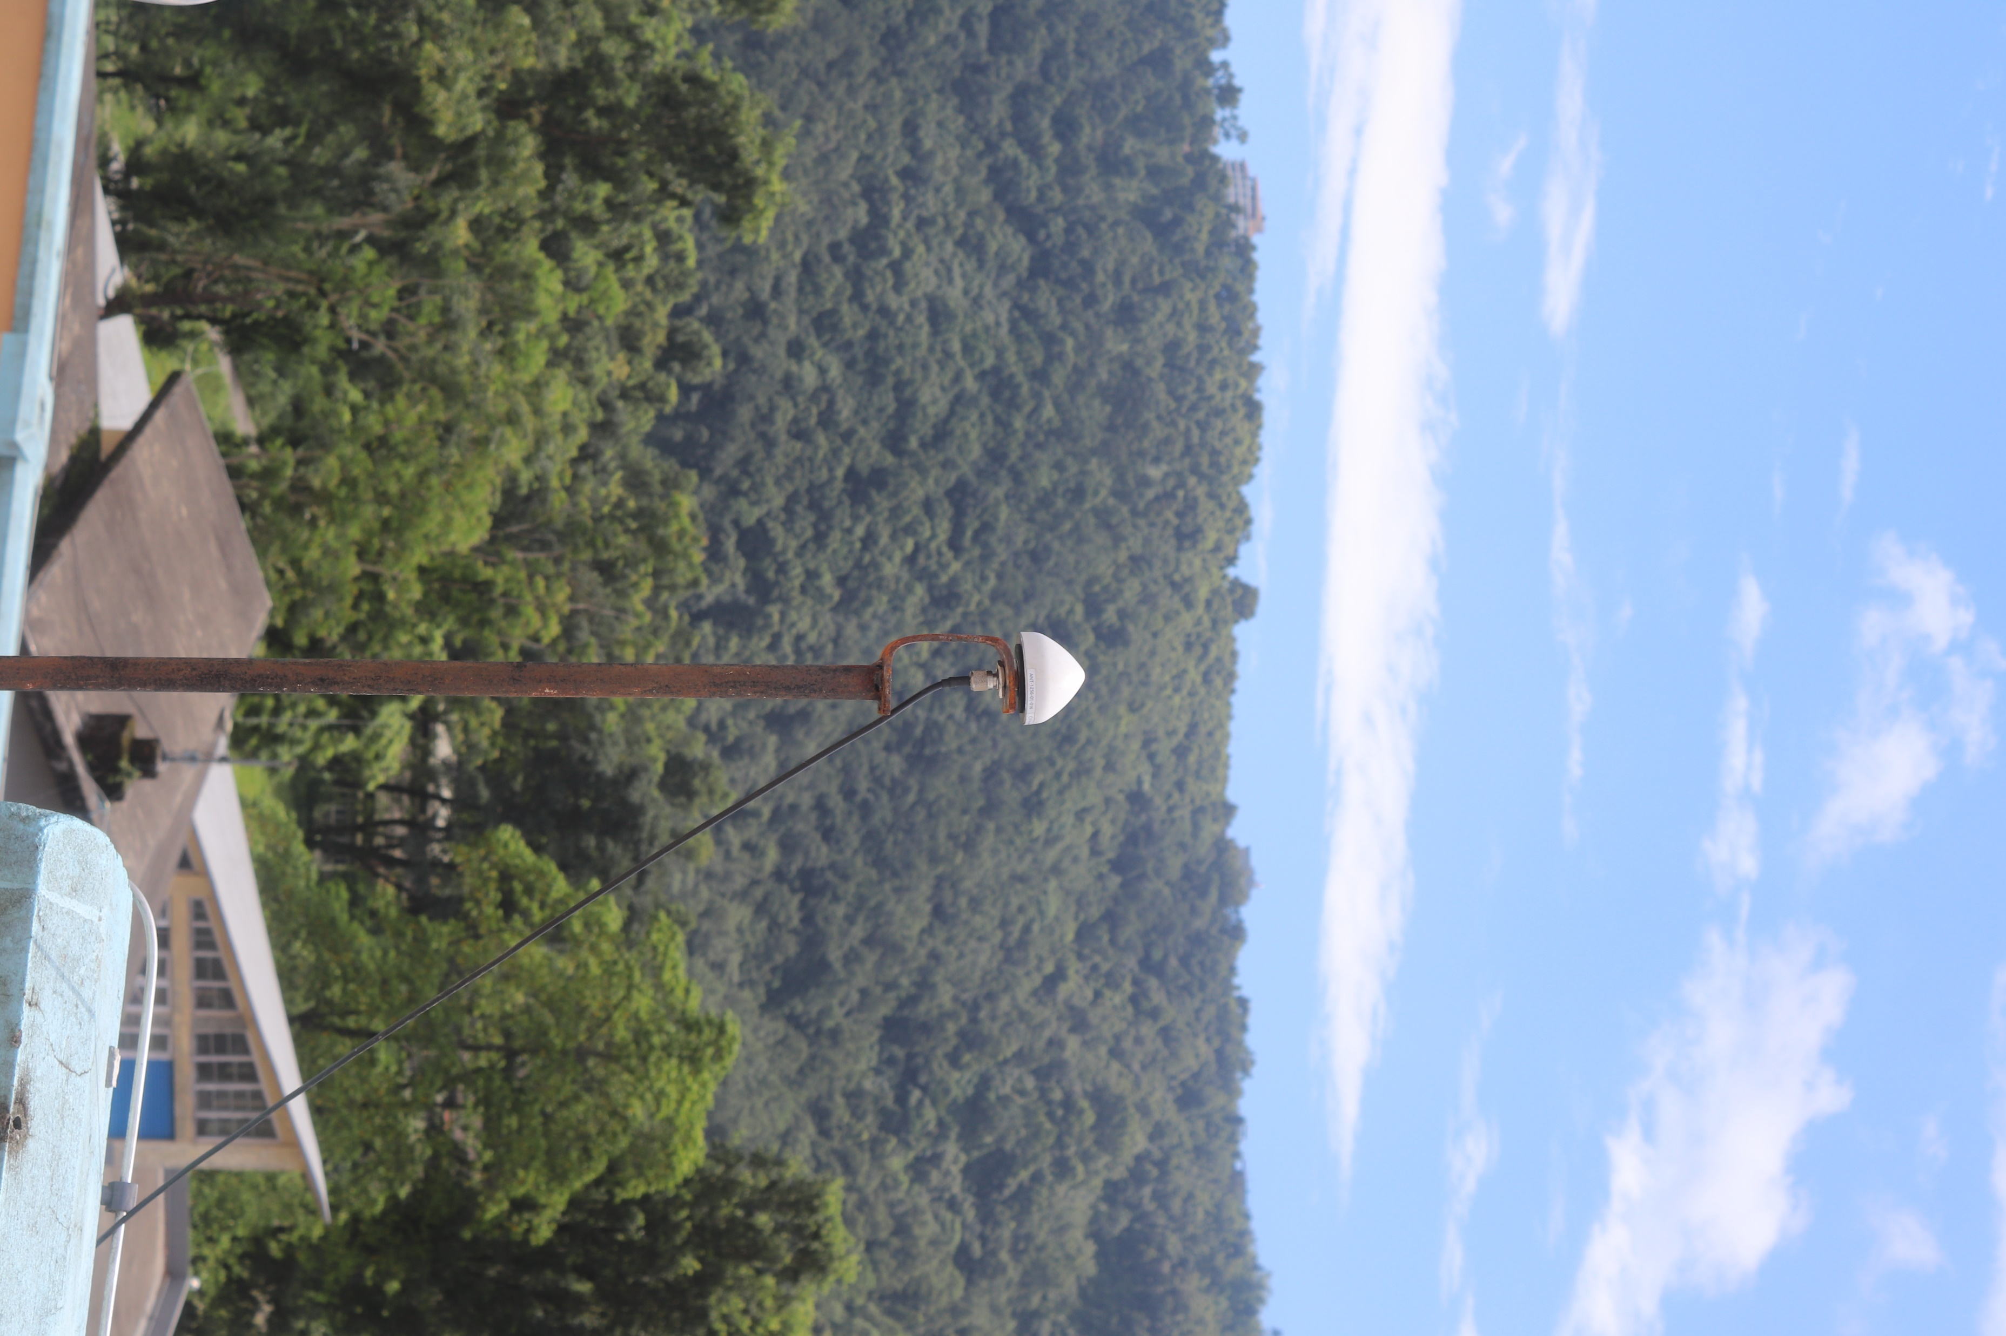
Satellite Positioning
Presented By:
Ajay Kumar Thapa

Slide 2
Satellite Positioning
1
Data Acquisition :
Getting Familiar with the sensors, receivers and Data Logging Platforms
2
Data Pre-processing :
Conversion of Binary Data Formats, Pre-processing of SBF, NMEA File Formats
3
Data Post-processing :
Post-processing in different modes, Visualization
4
Applications :
Applications of RAW GNSS Data

Slide 3
Data Acquisition:
i.
CORS Station:
ii.
Septentrio mosaic-CLAS:
iii.
MADOCA PPP:
iv.
U-blox receivers:

Slide 4
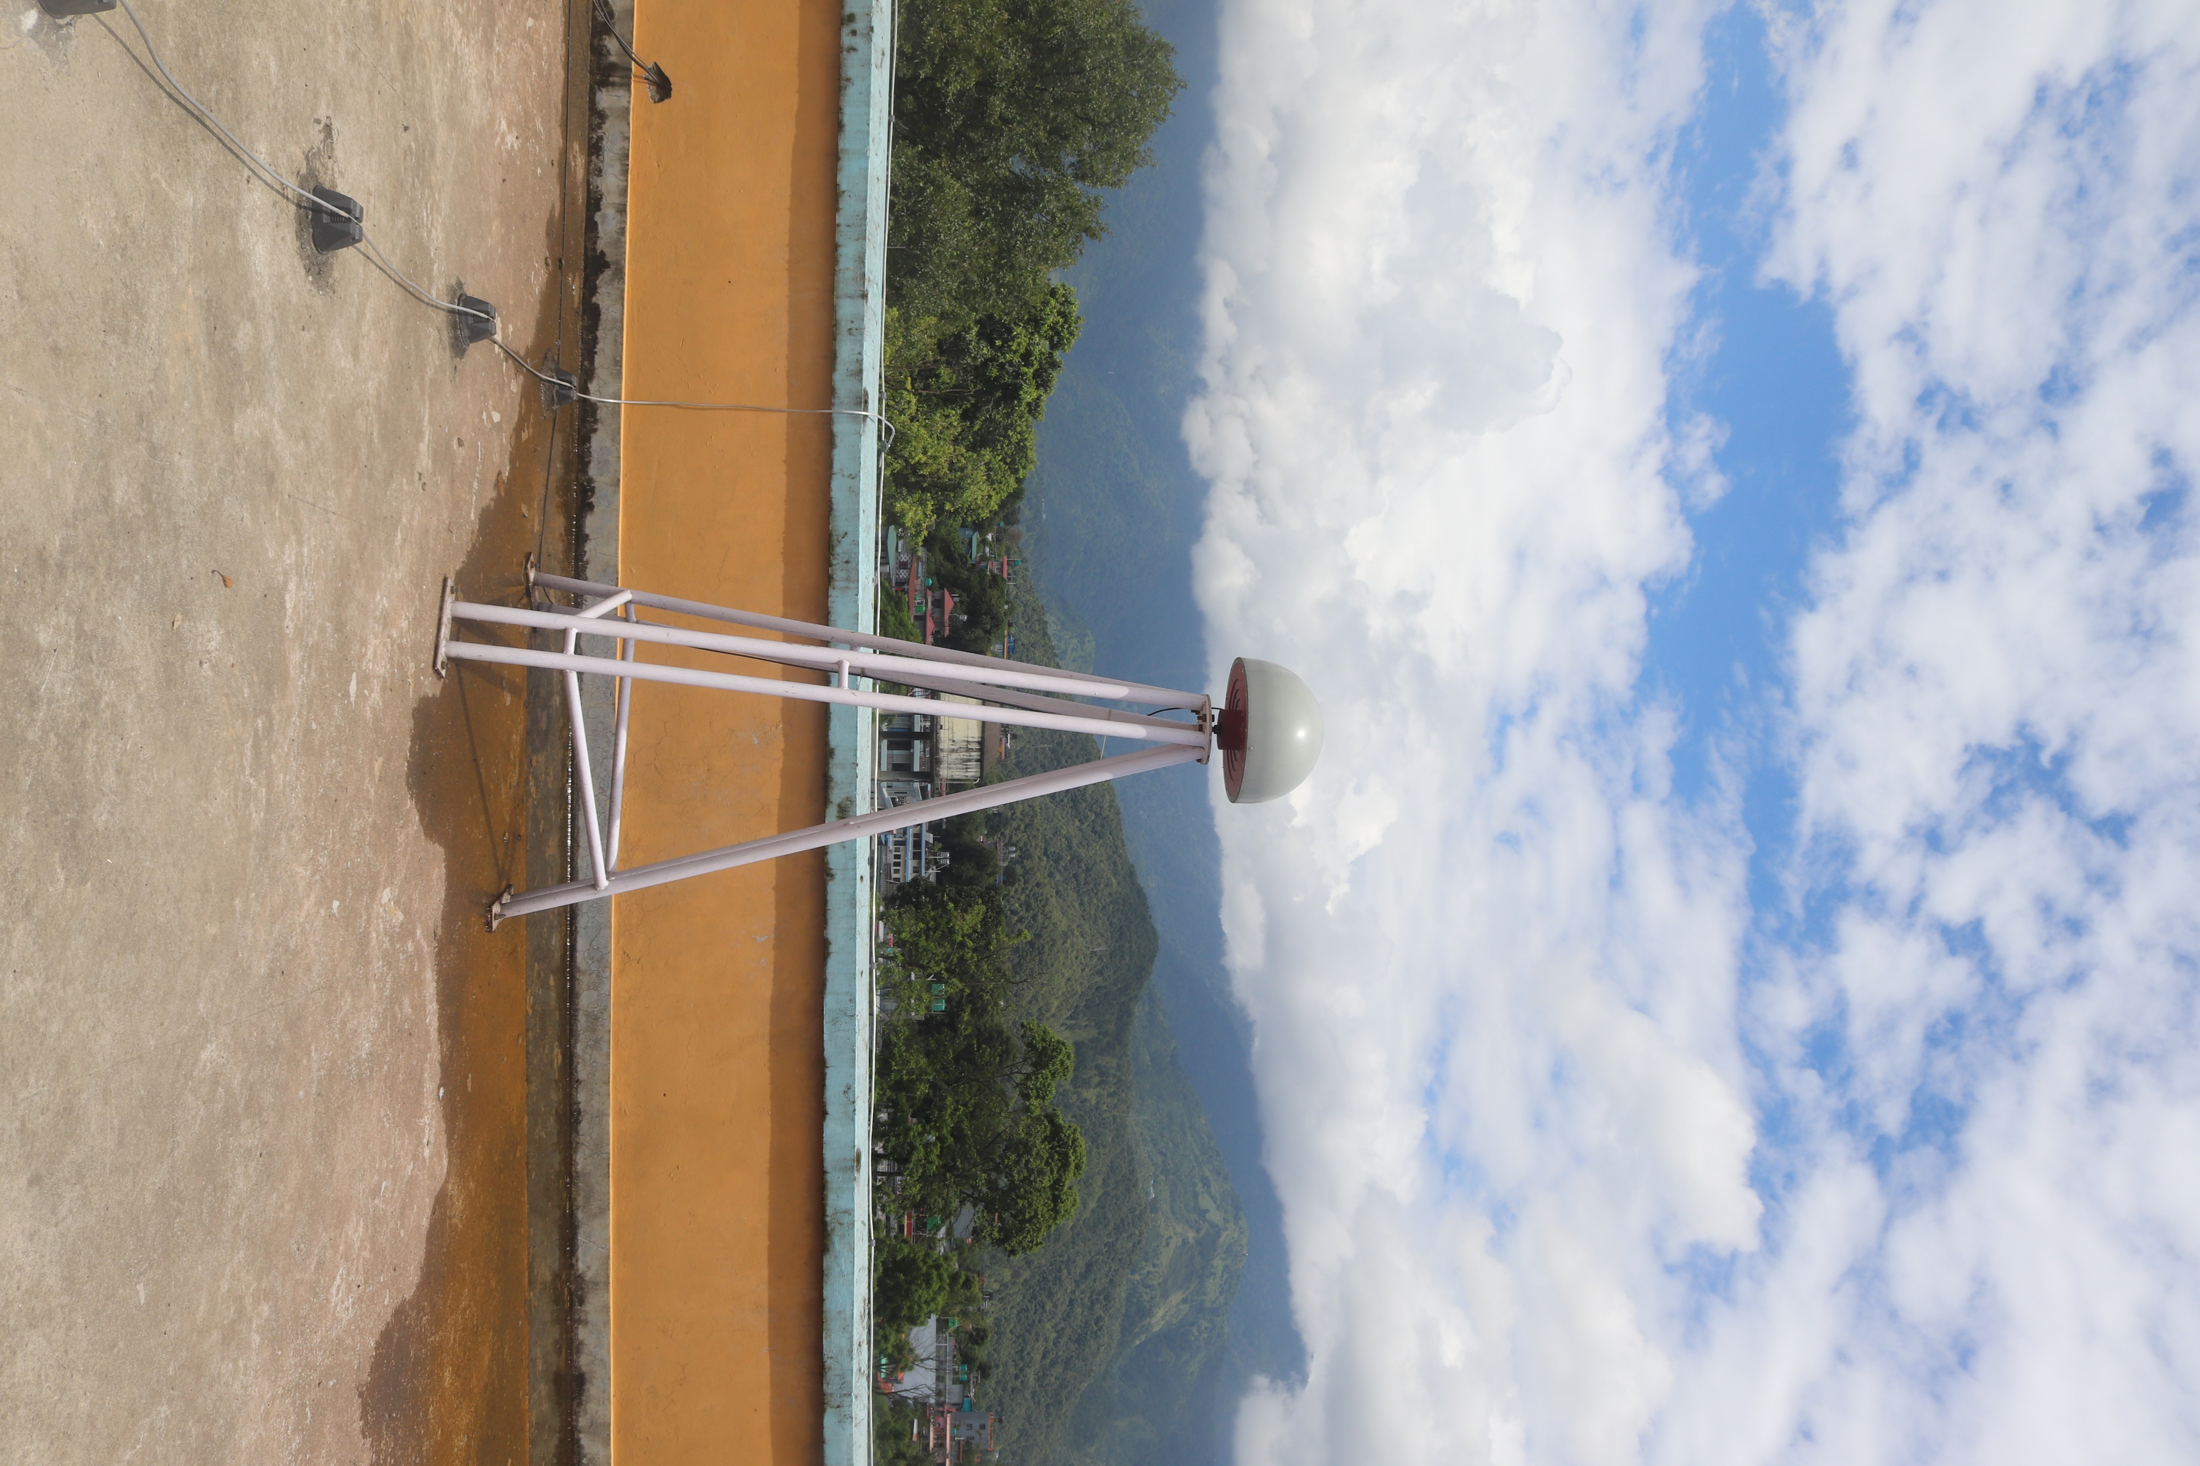
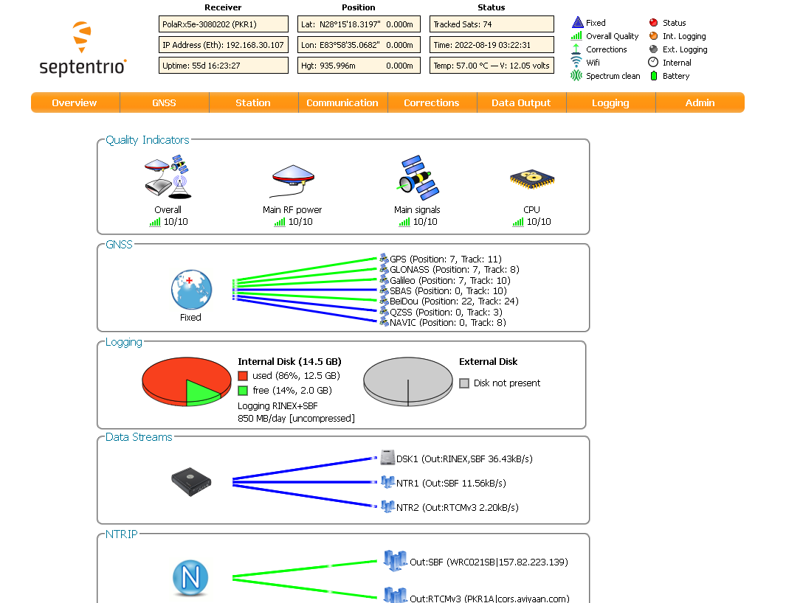
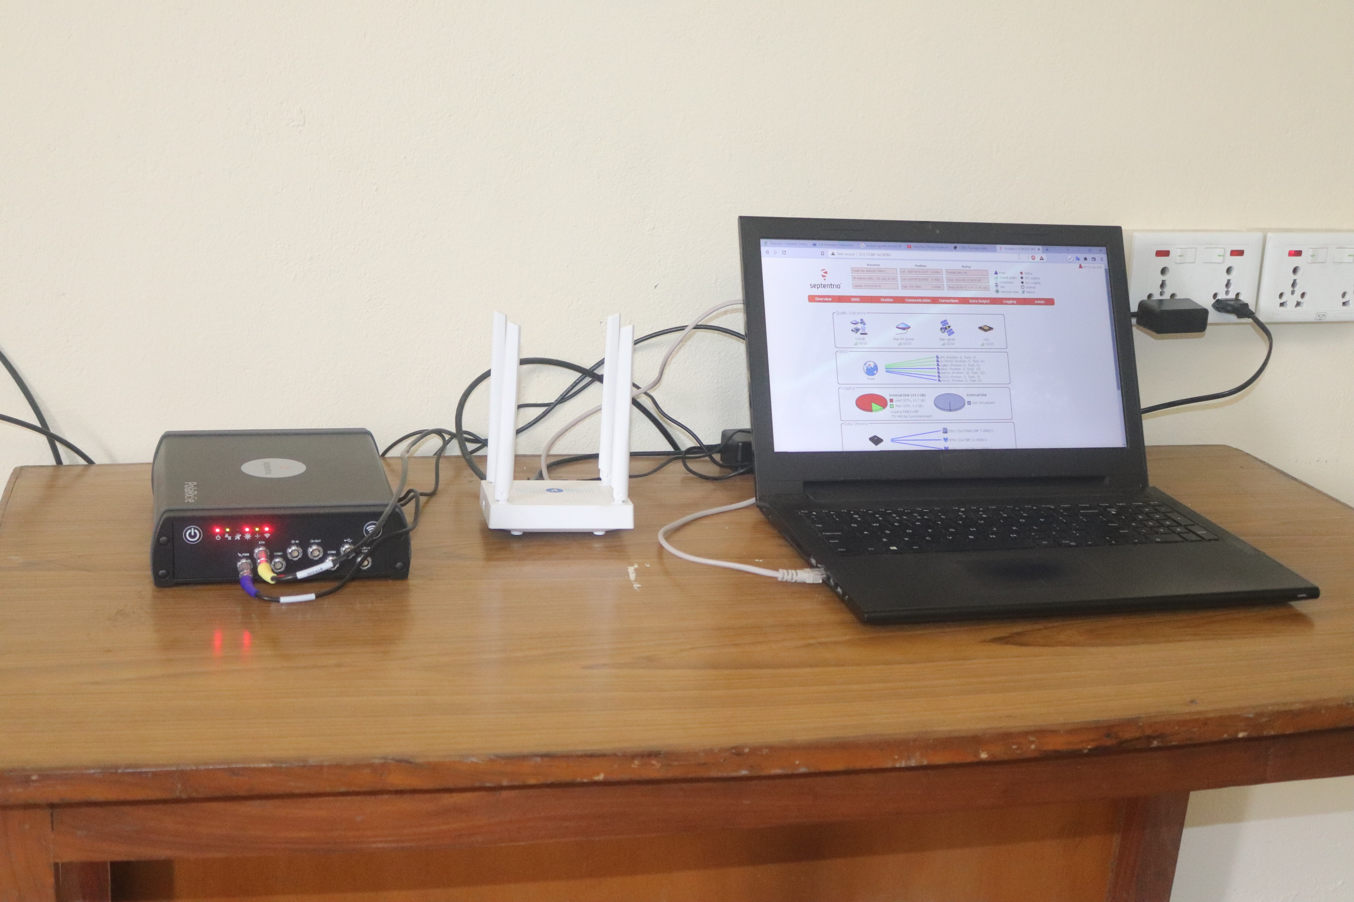
Data Acquisition:
i.
CORS Station:

Slide 5
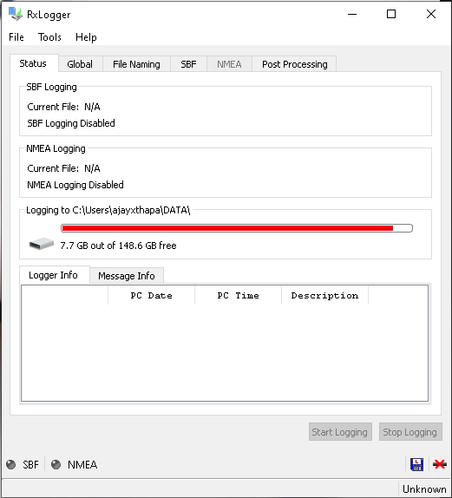

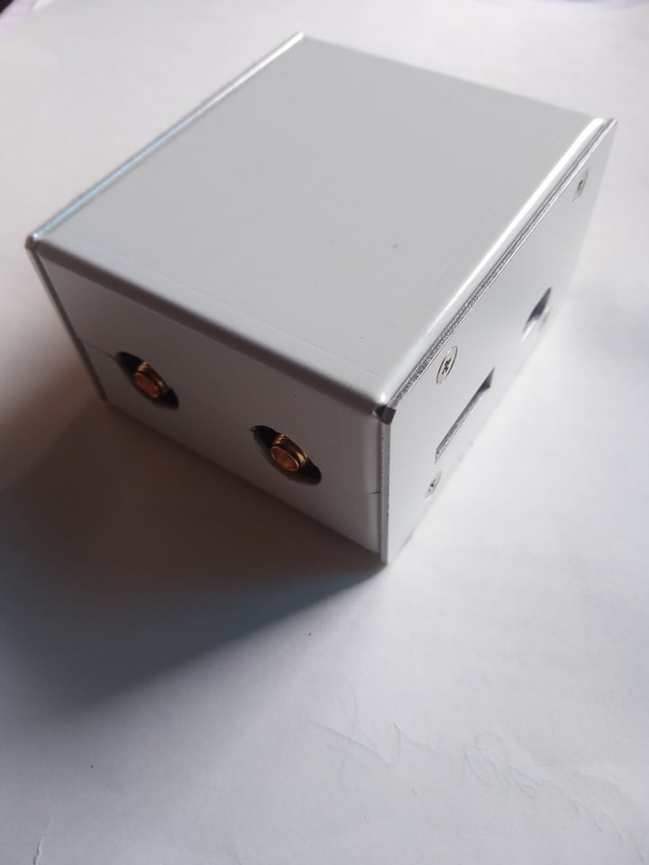
Data Acquisition:
ii.
Septentrio mosaic-CLAS:

Slide 6
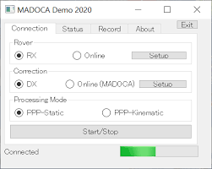
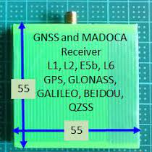
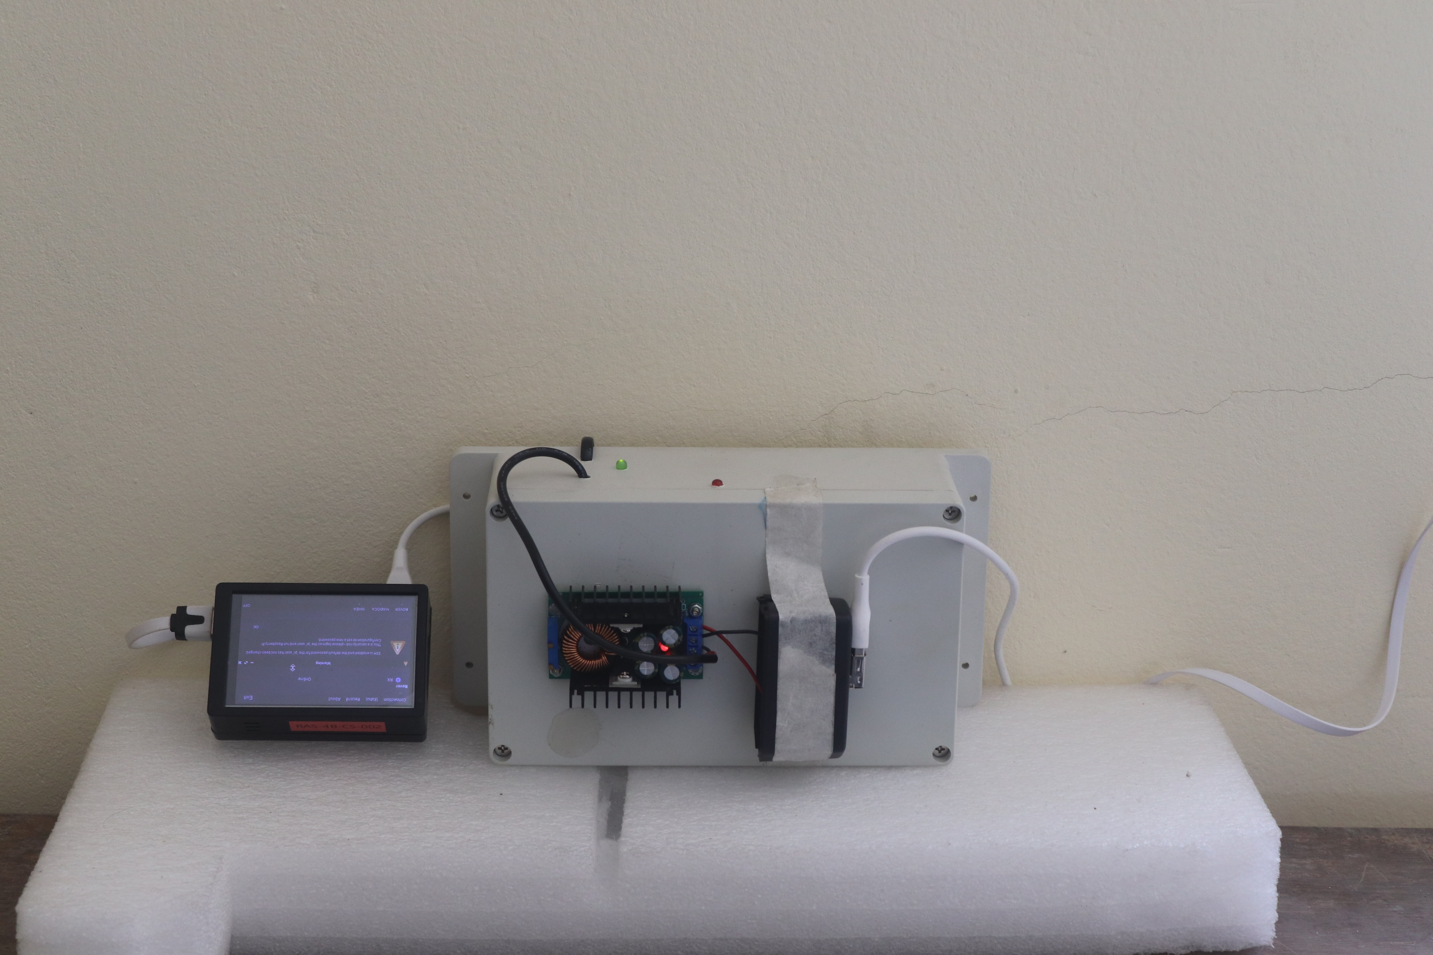
Data Acquisition:
iii.
MADOCA PPP:

Slide 7
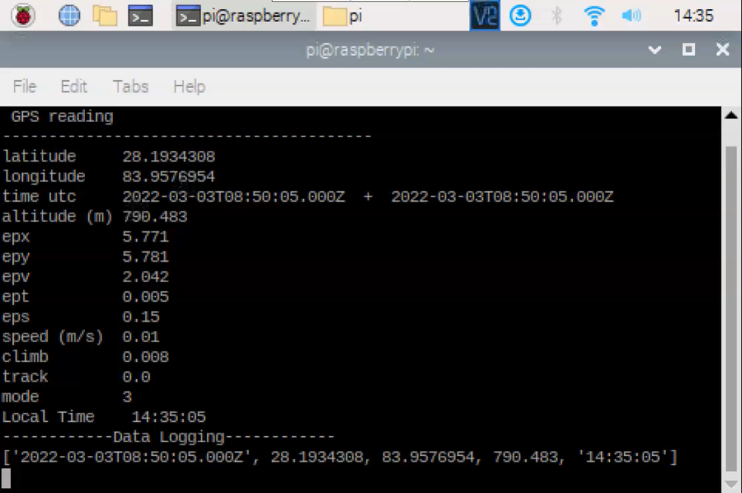
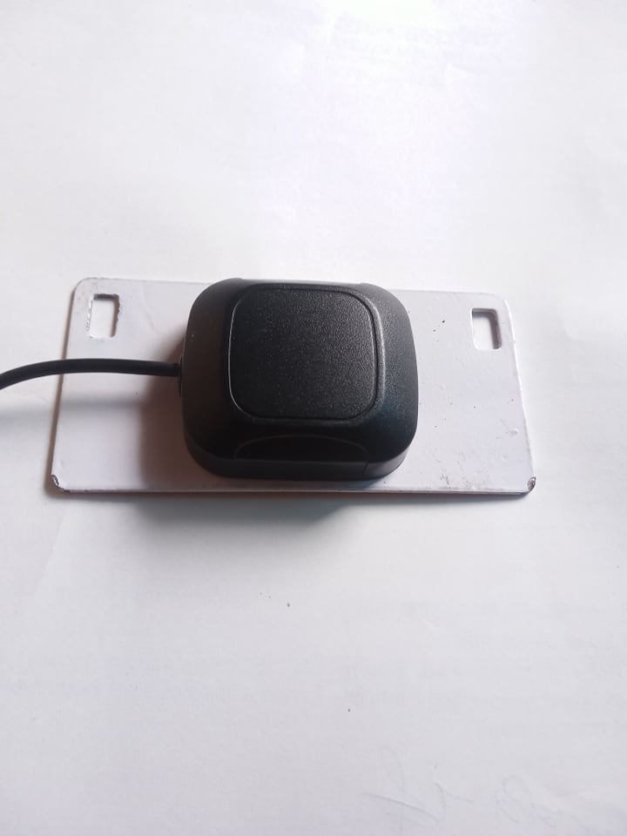
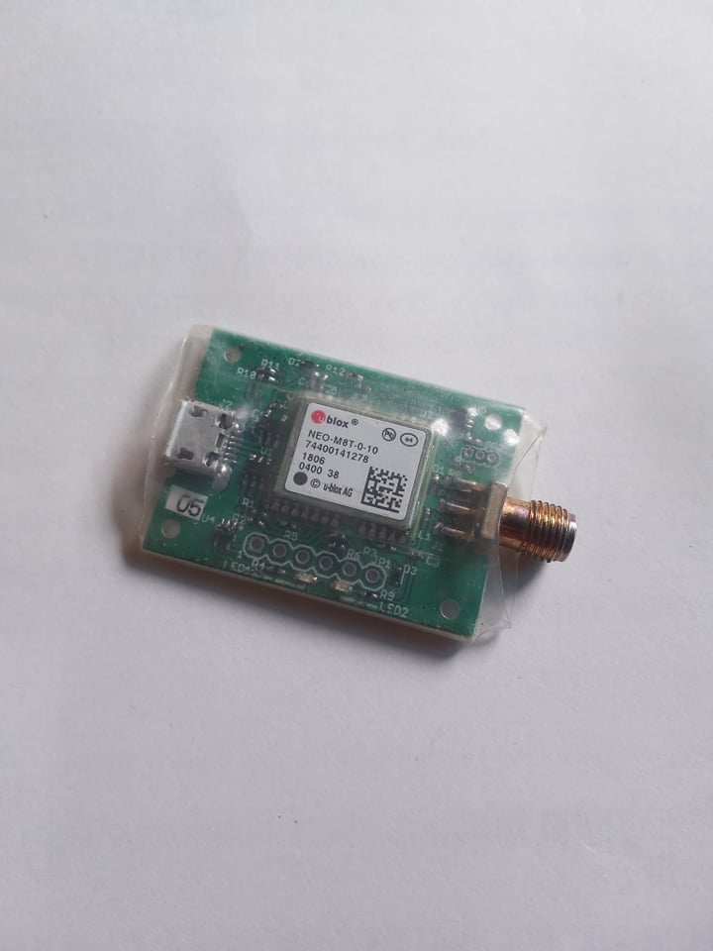
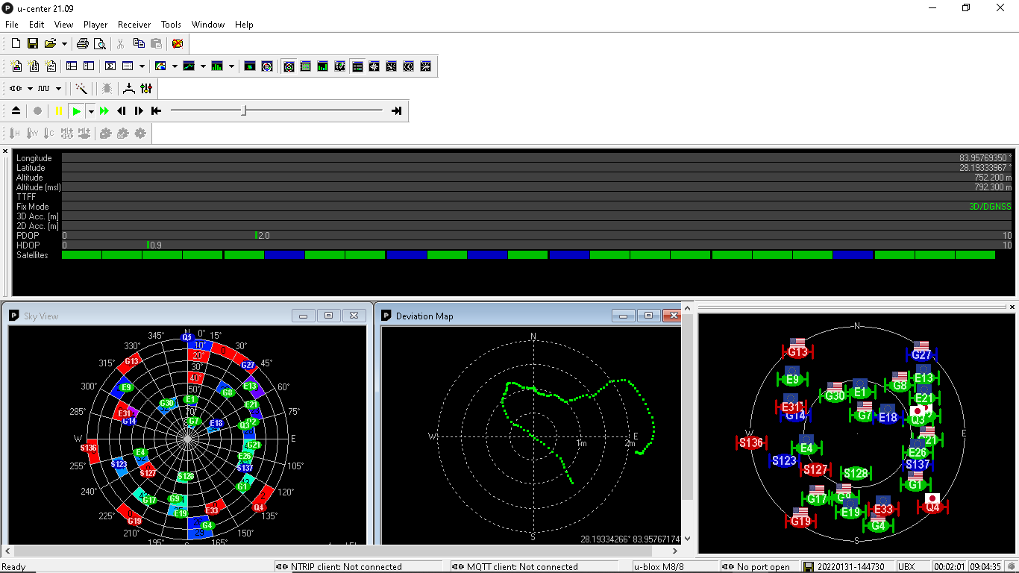
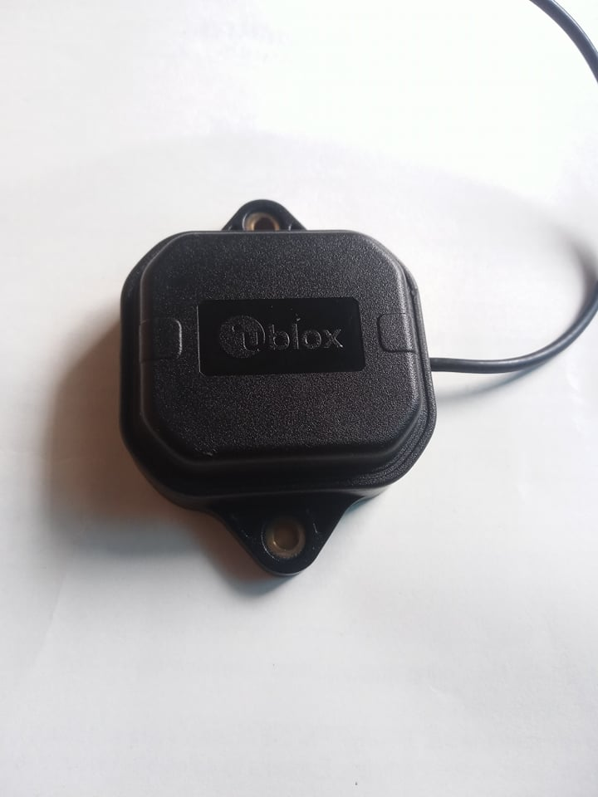
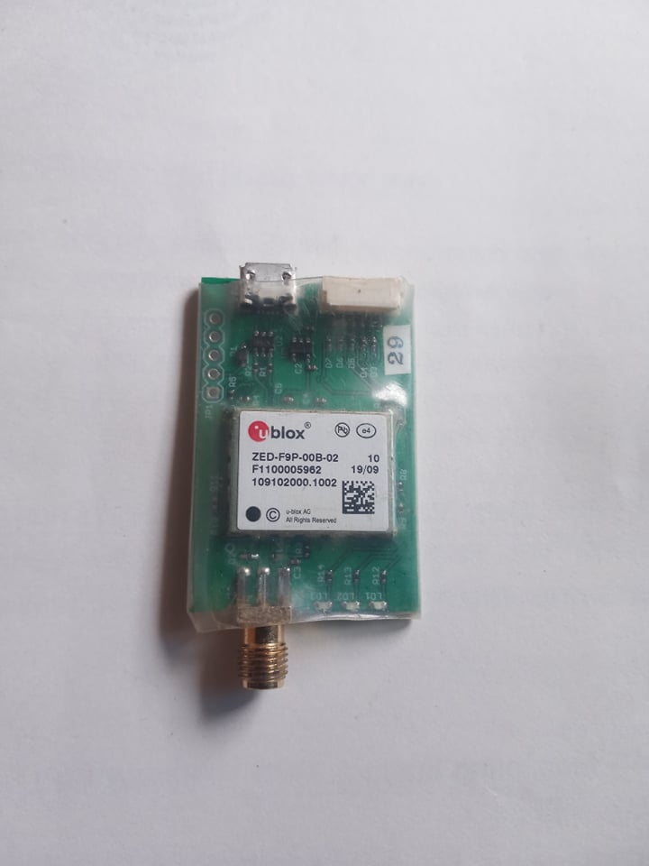
Data Acquisition:
iv.
U-blox receivers M8T/F9P:

Slide 8
Satellite Positioning
1
Data Acquisition :
Getting Familiar with the sensors, receivers and Data Logging Platforms
2
Data Pre-processing :
Conversion of Binary Data Formats, Aggregation of SBF, NMEA File Formats
3
Data Post-processing :
Post-processing in different modes, Visualization
4
Applications :
Applications of RAW GNSS Data

Slide 9
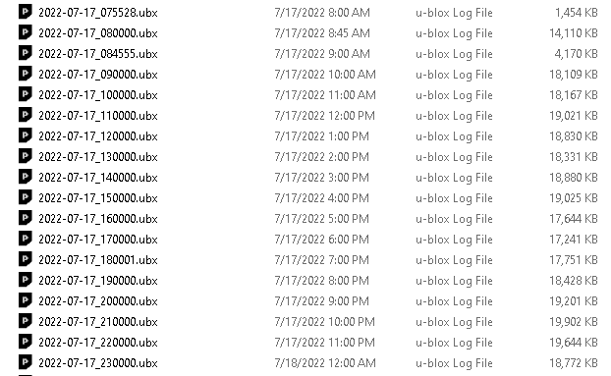
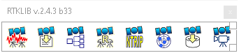
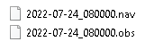
Data Pre-processing:
a.
For .UBX Files:
Multiple GNSS RAW Data Files
Single RINEX O/N Files

Slide 10
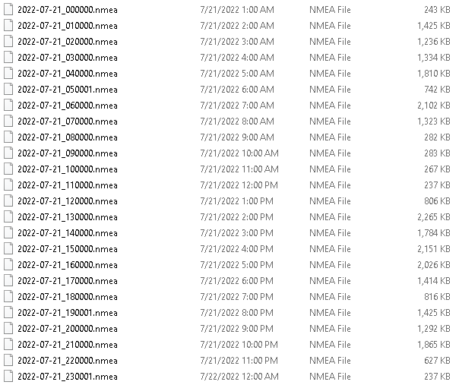
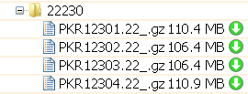
Data Pre-processing:
b.
For .SBF , .NMEA files:
Command Prompt:
copy /b *.nmea combined.nmea
Single .nmea file

Slide 11
Satellite Positioning
1
Data Acquisition :
Getting Familiar with the sensors, receivers and Data Logging Platforms
2
Data Pre-processing :
Conversion of Binary Data Formats, Aggregation of SBF, NMEA File Formats
3
Data Post-processing :
Post-processing in different modes, Visualization
4
Applications :
Applications of RAW GNSS Data

Slide 12
Data Post-processing:
a.
General Methodology:
Base Station
Rover Station
RTKLIB-RTKConv
RTKLIB-RTKConv
Observation File
Navigation File
Observation File
Navigation File
RTKLIB-RTKPost
Base Station Co-ordinate
For PPP: Additional Files
e.g. sp3,clk,DCB,atx
Solution

Slide 13
Satellite Positioning
1
Data Acquisition :
Getting Familiar with the sensors, receivers and Data Logging Platforms
2
Data Pre-processing :
Conversion of Binary Data Formats, Aggregation of SBF, NMEA File Formats
3
Data Post-processing :
Post-processing in different modes, Visualization
4
Applications :
Applications of RAW GNSS Data

Slide 14
Applications:
a.
PWV (Precipitable Water Vapor) calculation from GNSS data:

Slide 15
Applications:
b.
TEC (Total Electron Count) from GNSS Data:

Slide 16
Applications:
c.
Study of Urban Heat Island using GNSS Data:

Slide 17
Satellite Positioning
Presented By:
Ajay Kumar Thapa

